Slide 1
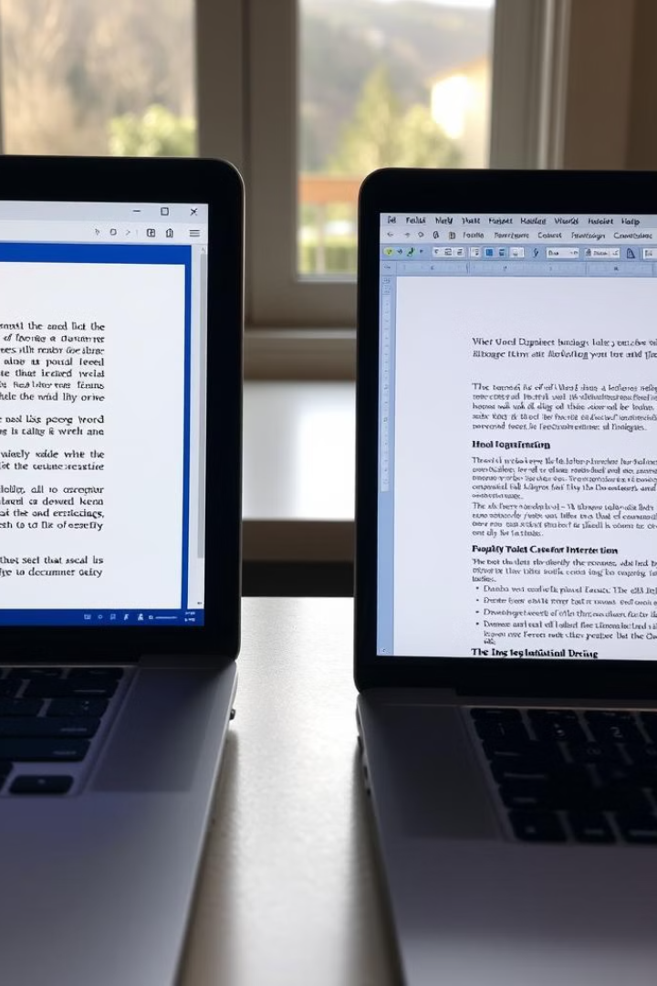
Microsoft Office 2007 vs. Microsoft Office 2021
Explore the evolution of Microsoft's flagship productivity suite, from the familiar 2007 version to the feature-rich 2021 release. Discover the key differences in user interface, core applications, productivity tools, and cloud integration that make each iteration unique.

Slide 2
Introduction: Overview of the two Office suites
Microsoft Office 2007
Microsoft Office 2021
Key Differences
Introduced a radical visual overhaul with the Ribbon interface, revolutionizing how users interact with Office applications.
Builds upon the foundation of 2007 with a modern, streamlined design and a host of new productivity features.
The two versions offer distinct user experiences, core application capabilities, and cloud integration options.

Slide 3
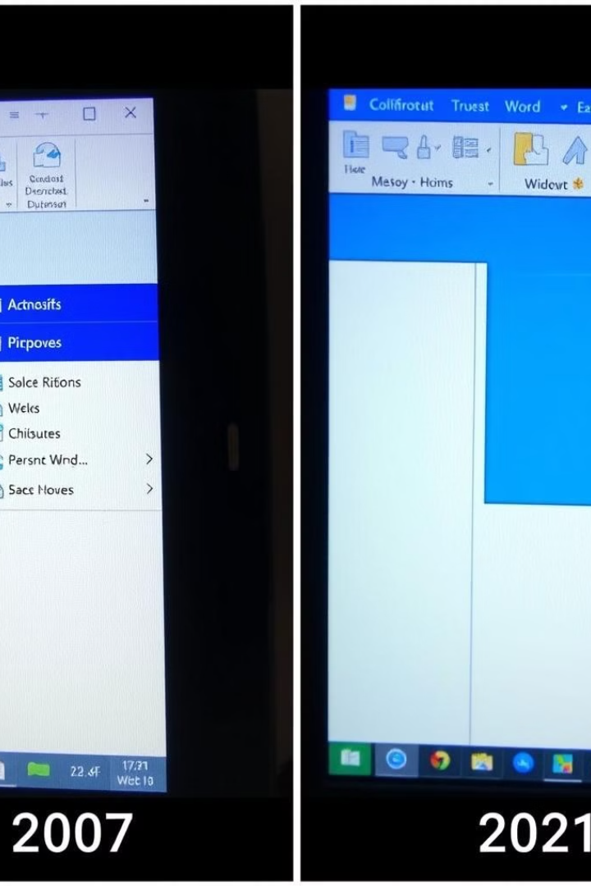
User Interface: Changes in design and layout
1
2007: Ribbon Interface
Replaced traditional menus and toolbars with a tabbed Ribbon system, providing a more intuitive and visually-driven experience.
2
2021: Modernized Design
Streamlined the Ribbon interface, introduced a cleaner layout, and added support for high-DPI displays and dark mode.
3
Contextual Customization
The 2021 version allows users to tailor the Ribbon and toolbars to their specific needs and workflows.

Slide 4
Core Applications: Comparison of key programs
2007 Suite
2021 Suite
Feature Enhancements
Included the classic Office applications: Word, Excel, PowerPoint, Outlook, Access, Publisher, and InfoPath.
Retains the core apps while adding newer tools like Microsoft Teams, OneDrive, and expanded web-based versions.
The 2021 versions boast improved collaboration, data analysis, and presentation capabilities across the applications.

Slide 5

Productivity Features: New tools and enhancements
1
Digital Ink and Touch
2
Data Visualization
Office 2021 supports advanced inking features and touch-based interactions for a more intuitive user experience.
Improved data analysis and visualization tools in Excel, including dynamic charts and interactive dashboards.
3
Collaboration Features
4
AI-Powered Assistance
Real-time co-authoring, cloud-based file sharing, and integrated communication tools for seamless teamwork.
Intelligent features like Editor, Designer, and Translator to enhance writing, presentations, and multilingual support.

Slide 6
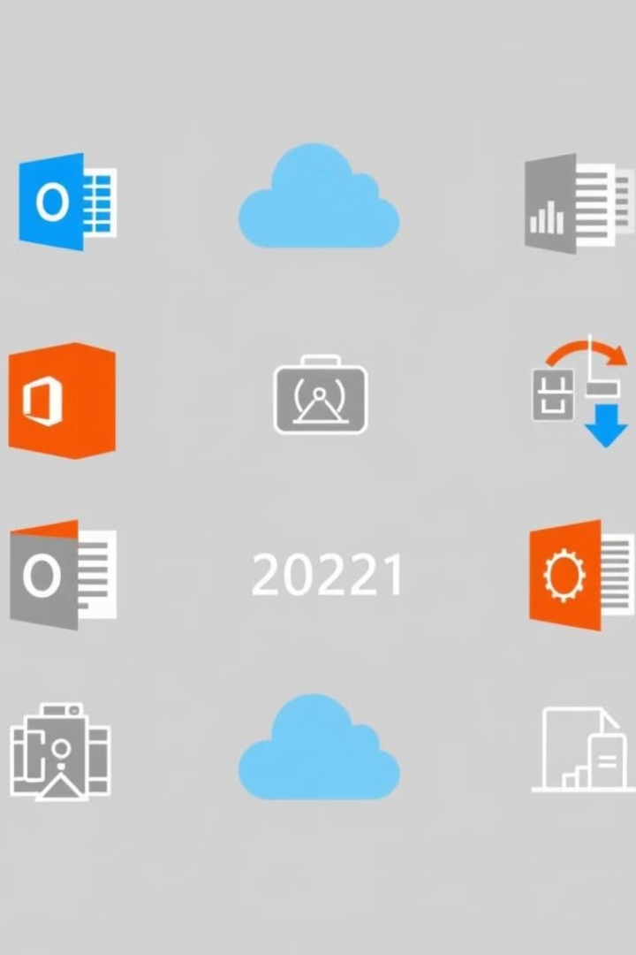
Cloud Integration: Improved cloud capabilities
OneDrive Integration
Web-Based Applications
Seamless cloud storage and file sharing through tight integration with Microsoft's OneDrive platform.
The 2021 suite includes fully-featured web versions of core apps, enabling access from any device.
Real-Time Collaboration
Mobile Accessibility
Concurrent editing, commenting, and co-authoring on documents stored in the cloud.
Optimized mobile apps for Office 2021 provide on-the-go productivity and accessibility.

Slide 7





Security and Compliance: Advancements in data protection
Data Encryption
Access Controls
Advanced encryption safeguards sensitive information stored in Office 2021 documents.
Granular permissions and rights management to control document sharing and modifications.
Regulatory Compliance
Backup and Recovery
Improved alignment with industry standards and regulations for data governance and privacy.
Seamless cloud-based backup and version control to protect against data loss.

Slide 8
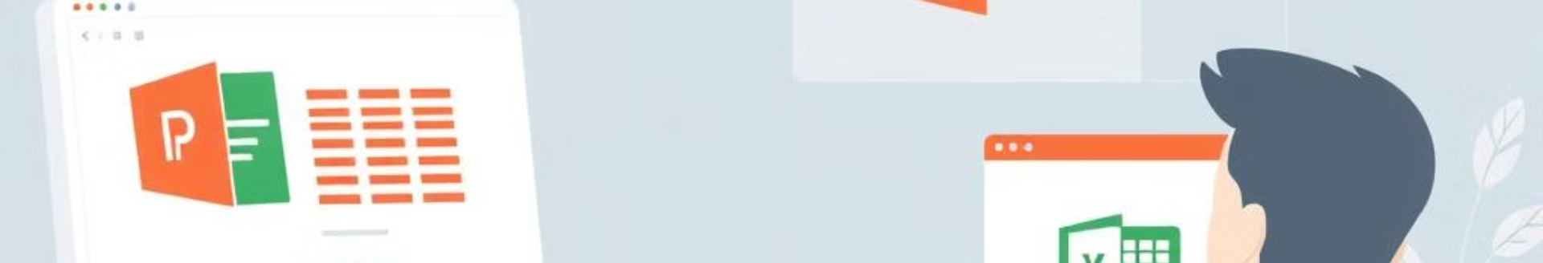



Performance and Efficiency: Faster processing and improved multitasking
Optimized Algorithms
Hardware Acceleration
Resource Management
Office 2021 leverages more efficient data processing and rendering algorithms for improved performance.
Utilizes the latest hardware capabilities, such as GPU-accelerated graphics and multi-core processors.
Better memory and CPU utilization allows for seamless multitasking across Office applications.

Slide 9

Conclusion: Recommendations and key takeaways
1
Modernized Experience
2
Improved Collaboration
Office 2021 offers a visually-appealing and streamlined user interface, with enhanced productivity features.
Seamless cloud integration and real-time co-authoring capabilities enable more efficient teamwork.
3
Enhanced Security
4
Recommended Upgrade
Robust data encryption, access controls, and compliance features provide stronger data protection.
For users seeking a more modern, feature-rich, and secure Office experience, upgrading to 2021 is highly recommended.
PRESENTATION BY – YASH PANCHAL & PARTH DESAI

